Slide 1

Chapter 7
Conjoint Analysis
Copyright © 2007
Prentice-Hall, Inc.

Slide 2
Chapter 7: Conjoint Analysis
LEARNING OBJECTIVES:
Upon completing this chapter, you should be able to do the following:
Explain the managerial uses of conjoint analysis.
Know the guidelines for selecting the variables to be examined by conjoint analysis.
Formulate the experimental plan for a conjoint analysis.
Understand how to create factorial designs.
Explain the impact of choosing rank choice versus ratings as the measure of preference.
Assess the relative importance of the predictor variables and each of their levels in affecting consumer judgments.
Apply a choice simulator to conjoint results for the prediction of consumer judgments of new attribute combinations.
Compare a main effects model and a model with interaction terms and show how to evaluate the validity of one model versus the other.
Recognize the limitations of traditional conjoint analysis and select the appropriate alternative methodology (e.g., choice-based or adaptive conjoint) when necessary .

Slide 3
Conjoint Analysis Defined
Conjoint analysis . . . is a dependence technique used to understand how respondents develop preferences for products or services. The dependent variable is a measure of respondent preference and can be metric or nonmetric (choice-based conjoint). The independent variables are dummy variables representing attributes of multiattribute products or services.

Slide 4
Conjoint Analysis . . .
Is not a new “technique” but an application of techniques we have covered already:
  Metric conjoint analysis is a regression analysis.
  Choice-based conjoint is a discrete regression (e.g., logit).
The researcher first constructs a set of real or hypothetical products by combining selected levels of each attribute (factor):
  In most situations, the researcher will need to create an experimental design.
  Some computer programs will create the design (Sawtooth Software, SPSS Conjoint).
These combinations or profiles are then presented to respondents, who provide their overall evaluations.

Slide 5

Conjoint Analysis . . .
Example:
A decompositional technique:
  Conjoint decomposes stated overall preference to determine preferences for each attribute. That is, the researcher collects data on the overall preference for a stimulus and decomposes it to ratings for the individual attributes.
  With compositional techniques the researcher collects ratings on many product characteristics and then compares the ratings to an overall preference rating to develop a predictive model.
Individual-, aggregate-, or segment-level models can be estimated.

Slide 6
Managerial Uses of Conjoint Analysis . . .
  Define the object or concept with the optimum combination of features.
  Show the relative contributions of each attribute and each level to the overall evaluation of a product.
  Predict customer judgments among objects with differing sets of features.
  Isolate segments of potential customers who place differing importance weights on features (homogeneous within segments, heterogeneous between segments).
  Identify market opportunities by exploring the market potential for feature combinations not currently available.

Slide 7
Stage 1: Objectives of Conjoint Analysis
To determine the contributions of predictor variables and their levels in the determination of consumer preferences.
To establish a valid model of consumer judgments – two major issues:
    Define the total utility of object (all attributes that create or detract from overall utility)
    Specify factors that best differentiate between objects.

Slide 8
Rules of Thumb 7–1
Objectives of Conjoint Analysis
Conjoint analysis is unique from other multivariate techniques in that:
  It is a form of decompositional model that has many elements of an experiment
  Consumers only provide overall preference rating for objects (stimuli) created by the researcher
  Stimuli are created by combining one level (value) from each factor (attribute)
  Each respondent evaluates enough stimuli so that conjoint results are estimated for each individual

Slide 9
Rules of Thumb 7–1 Continued . . .
Objectives of Conjoint Analysis
A “successful” conjoint analysis requires that the researcher:
  Accurately define all of the attributes (factors) that have a positive and negative impact on preference
  Apply the appropriate model of how consumers combine the values of individual attributes into overall evaluations of an object
Conjoint analysis results can be used to:
  Provide estimates of the “utility” of each level within each attribute
  Define the total utility of any stimuli so that it can be compared to other stimuli to predict consumer choices (e.g., market share)

Slide 10
Stage 2: Design of a Conjoint Analysis
    Selecting a Conjoint Analysis methodology:
      Traditional conjoint analysis.
      Adaptive conjoint analysis.
      Choice-based conjoint analysis.
    Designing stimuli – selecting and defining factors and levels:
      General characteristics of factors and levels.
        Communicable measures.
        Actionable (not fuzzy) measures.

Slide 11
Stage 2 continued . . .
      Specification issues regarding factors:
        Number of factors – as factors and levels are added, more stimuli are needed, or else reliability of parameters is reduced.
        Fractional factorial designs may be used when the number of factors is large.
        Factor multicollinearity – some factors are necessarily correlated, such as horsepower and gas mileage, but they may be orthogonal in the experimental design.
        Unique role of price as a factor – correlated with many other factors, price-quality inferences.
      Specification issues regarding levels:
        Balance or equalize the number of levels across factors.
        Range of the factor levels.
    Specifying the basic model form:
      Composition rule – how does the respondent combine the part-worths to obtain overall worth?

Slide 12
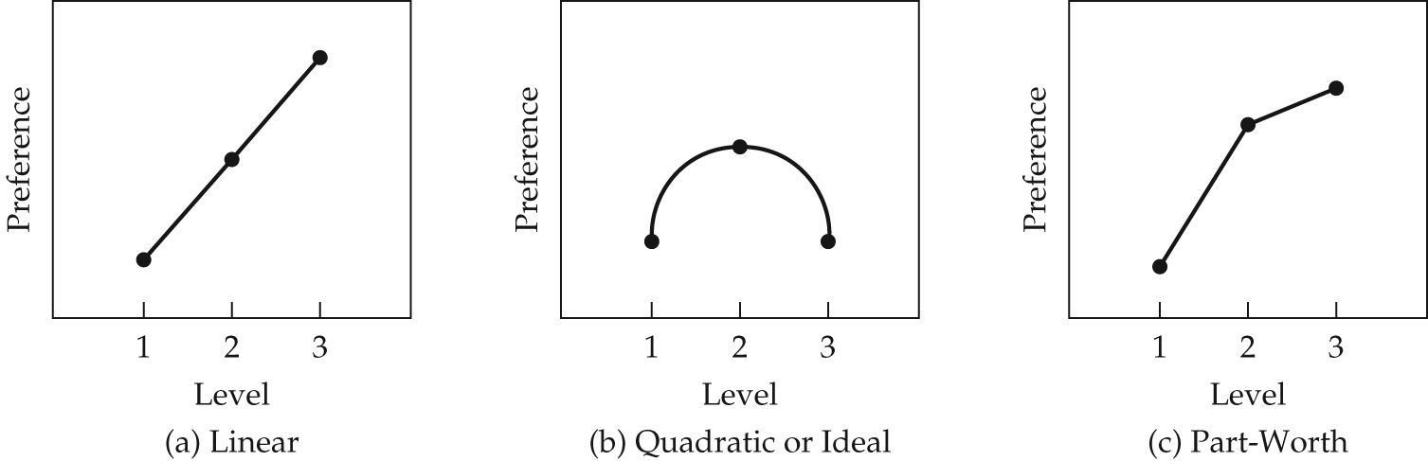
The Composition Rule: Additive vs. Interactive
    Additive model
    Interactions – some attribute levels are more valuable when paired with certain levels of other attributes. Also, testing interactions requires more stimuli to be evaluated, but may be a more realistic picture of judgments.
    Selecting the part-worth relationship:
      Linear
      Quadratic (ideal-point)
      Part-worth

Slide 13
Conjoint Analysis . . . Data Collection
    Choosing a presentation method:
        Trade-off presentation – compares attributes two at a time.
        Full-profile presentation – most popular and most realistic..
        Pairwise presentation – a combination of other two methods.
    Creating the stimuli:
      Trade-off presentation: number of trade-off matrices is N(N-1)/2, where N is the number of factors.
      Full-Profile presentation:
        Factorial design
        Fractional factorial design
        Bridging design

Slide 14
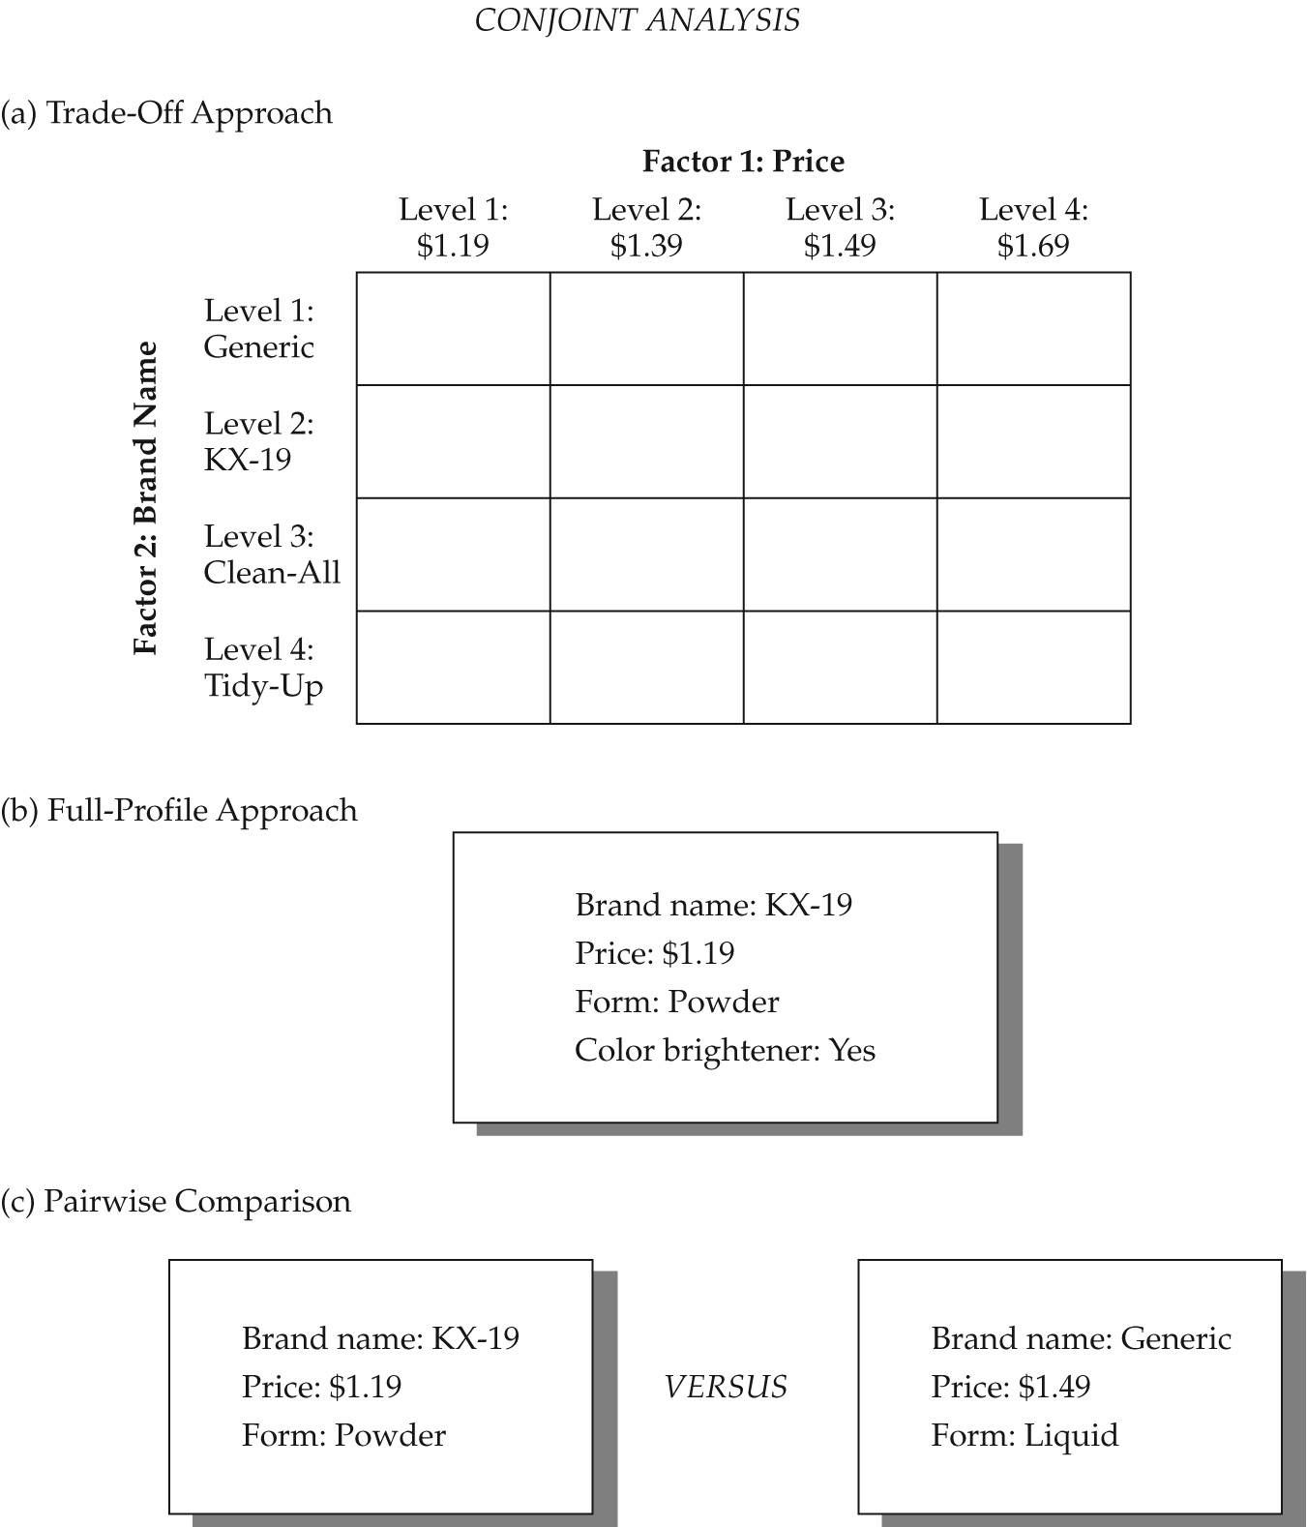
Conjoint Analysis . . .

Slide 15
Unacceptable Stimuli . . .
      Creation of an optimal design, with orthogonality and balance, does not mean all stimuli will be acceptable for evaluation, for several reasons:
        Obvious stimuli.
        Unbelievable stimuli.
        Combinations of attributes may be precluded.

Slide 16
Eliminating Unacceptable Stimuli . . .
      Courses of Action:
        Generate another fractional factorial design.
        Use a nearly orthogonal design.
        Exclude prohibited pairs.

Slide 17
Conjoint Analysis . . .
      Selecting a measure of consumer preference:
        Rankings (requires transformation or specialized computer software)
        Ratings
        Choices
      Survey administration
        Personal interviews.
        Respondent burden retesting.

Slide 18
Rules of Thumb 7–2
Designing the Conjoint Task
Researchers must select one of three methodologies based on number of attributes, choice task requirements and assumed consumer model of choice:
  Traditional methods are best suited when the number of attributes is less than 10, results are desired for each individual and the simplest model of consumer choice is applicable.
  Adaptive methods are best suited when larger numbers of attributes are involved (up to 30), but require computer-based interviews.
  Choice-based methods are considered the most realistic, can model more complex models of consumer choice and have become the most popular, but are generally limited to six of fewer attributes.
The researcher faces a fundamental tradeoff in the number of factors included:
  Increase them to better reflect the “utility” of the object versus
  Minimize them to reduce the complexity of the respondent’s conjoint task and allow use of any of the three methods.

Slide 19
Rules of Thumb 7–2 Continued . . .
Designing the Conjoint Task
Specifying factors (attributes) and levels (values) of each factor must ensure that:
  Factors and levels are distinct influences on preference defined in objective terms with minimal ambiguity, thereby generally eliminating emotional or aesthetic elements.
  Factors generally have the same number of levels.
Interattribute correlations (e.g., acceleration and gas mileage) may be present at minimal levels (.20 or less) for realism, but higher levels must be accommodated by:
  Creating a “superattribute” (e.g., performance).
  Specifying prohibited pairs in the analysis to eliminate unrealistic stimuli (e.g., fast acceleration and outstanding gas mileage).
  Constraining the model estimation to conform to pre-specified relationships.
Price requires special attention since:
  It generally has interattribute correlations with most other attributes (e.g., price-quality relationship).
  It uniquely represents in many situations what is “traded-off” in cost for the object.
  Substantial interactions with other variables may require choice-based conjoint or multi-stage conjoint methods.

Slide 20
Rules of Thumb 7–3
Specifying Model Form and Part-Worth Relationships
Researcher can choose between two basic model forms based on the assumed composition rule for individuals:
  Additive model – assumes the simplest type of composition rule (utility for each attribute is simply added up to get overall utility) and requires the simplest choice task and estimation procedures.
  Interactive model – adds interaction terms between attributes to more realistically portray the composition rule, but requires a more complex choice task for the respondent and estimation procedure.
Additive models generally suffice for most situations and are the most widely used.

Slide 21
Rules of Thumb 7–3 Continued . . .
Specifying Model Form and Part-Worth Relationships
Estimating the utility of each level (known as part-worths) can follow one of three relationships:
  Linear – requires that the part-worths be linearly related, but may be unrealistic except for specific types of attributes.
  Quadratic – most appropriate when there is expected to be an “ideal point” in the attribute levels.
  Separate – makes each part-worth estimate independently of other levels, but is most likely to encounter reversals (violations of the hypothesized relationship).

Slide 22
Rules of Thumb 7–4
Data Collection
Data collection by traditional methods of conjoint analysis:
  Generally are accomplished with some form of full-profile approach using a stimulus defined on all attributes.
Increasing the number of factors and/or levels above the simplest task (two or three factors with only two or three levels each) requires some form of fractional factorial design that specifies a statistically valid set of stimuli.
Alternative methodologies (adaptive or choice-based methods) provide options in terms of the complexity and realism of the choice task that can be accommodated.
Respondents should be limited to evaluating no more than 30 stimuli regardless of the methodology used.

Slide 23
Stage 3: Assumptions of Conjoint Analysis
    Few statistical assumptions needed.
    Conceptual assumptions are important (e.g., main effects vs. interactive).

Slide 24
Stage 4: Estimating the Conjoint Model and Assessing Overall Fit
    Selecting an estimation technique:
      Rank-order evaluations require specialized programs (e.g., MONANOVA, LINMAP).
      Ratings: Multiple regression.
      Choices: Logit, probit.
      Bayesian analysis now becoming available
    Evaluating goodness of fit:
      Potential for overfitting.
      Validation or holdout stimuli for individual-level analysis.
      Validation or holdout respondents for aggregate-level analysis.

Slide 25
Stage 5: Interpreting the results
      Aggregate vs. Disaggregate analysis:
        Individual-level part-worths can be clustered to form segments.
        Finite mixture conjoint models form segments automatically.
        Aggregate analysis may predict market shares well but not individual preferences.
        The most important factor is the one with the greatest range of part-worths.

Slide 26
Examining the Estimated Part-Worths
      Ensuring Practical Relevance.
      Assessing Theoretical Consistency – reversals.

Slide 27
Reversals . . .
      Factors contributing to reversals:
        Respondent effort.
        Data collection method.
        Research context.
      Identifying reversals – graphical analysis.
      Remedies for reversals:
        Do nothing if only a few.
        Apply constraints.
        Delete respondents.

Slide 28
Rules of Thumb 7–5
Estimating a Conjoint Model
The selection of an estimation method is straightforward:
  The most common method is a regression-based approach applicable with all metric preference measures
  Using rank order preference data requires more specialized estimation (e.g., MONANOVA)
Bayesian methods are emerging that allow for individual level models to be estimated where not previously possible, but they require larger samples, are more computationally intensive and not as widely available
Goodness of fit should be assessed with:
  Coefficient of determination (R²) between actual and predicted preferences.
  Measures based on the rank orders of the predicted and actual preferences.
  Measures for both the estimation sample and a hold-out or validation sample of additional stimuli not used in the estimation process.

Slide 29
Rules of Thumb 7–6
Interpreting and Validating Conjoint Results
Results should be estimated for each individual unless:
  The conjoint model requires aggregate-level estimates (i.e., some form of choice-based conjoint).
  The population is known to be homogeneous with no variation between individual preference structures.
Part-worth estimates are generally scaled to a common basis to allow for comparison across respondents.
Theoretically-inconsistent patterns of part-worths, known as reversals, can give rise to deletion of a respondent unless:
  Their occurrence is minimal,
  Constraints are applied to prohibit reversals.
Attribute importance must be derived based on the relative ranges of part-worths for each attribute.
Validation must occur at two levels:
  Internal validation – testing whether or not the appropriate composition rule has been selected (i.e., additive or interactive) and is done in a study pretest.
  External validation – assessing the predictive validity of the results in an actual setting. The researcher must always ensure the sample is representative of the population of study.

Slide 30
Stage 6: Validation of the Conjoint Results
Internally
Externally

Slide 31
Managerial Applications of Conjoint Analysis
    Segmentation – groups respondents with similar part-worths to identify segments.
    Profitability analysis – if the cost of each feature is known, the cost of each product can be combined with the expected market share and sales volume to predict its profitability.
    Conjoint simulators – uses “what-if” analysis to predict the share of preferences a stimulus is likely to capture in various competitive scenarios of interest to management.

Slide 32
Conjoint Simulations
    Step 1: Specify the Scenario(s)
    Step 2: Simulate the Choices
    Step 3: Calculate Share of Preference

Slide 33
Alternative Conjoint Methods
  Self-explicated conjoint models
    Respondent provides a rating of the desirability of each level of an attribute and then rates the relative importance of the attribute overall.
    Part-worths are calculated by combining these ratings.
    This is a compositional approach.
    If number of factors cannot be reduced to a reasonable level for a traditional conjoint analysis, this may be an option.
  Hybrid conjoint analysis
    Combines self-explicated and traditional conjoint models
    Self-explicated values are used to create small subsets of stimuli for respondents to evaluate.
    Collectively, all stimuli are evaluated by a portion of the respondents.
    Suitable alternative when the number of attributes is large
    ACA, Sawtooth Software

Slide 34
Rules of Thumb 7–7
Alternative Conjoint Models
When 10 or more attributes are included in the conjoint variate, two alternative models are available:
  Adaptive models can easily accommodate up to 30 attributes, but require a computer-based interview.
  Self-explicated models can be done through any form of data collection, but represent a distinct departure from traditional conjoint methods.
Choice-based conjoint models have become the most popular format of all, even though they generally accommodate no more than six attributes. Their popularity is based on:
  Use of a realistic choice task of selecting most preferred stimulus from a choice set of stimuli, including a “No Choice” option
  Ability to more easily estimate interaction effects.
  Increased availability of software, particularly with Bayesian estimation options.

Slide 35
Description of HBAT Primary Database Variables
Variable Description Variable Type
Data Warehouse Classification Variables
X1 Customer Type nonmetric
X2 Industry Type nonmetric
X3 Firm Size nonmetric
X4 Region nonmetric
X5 Distribution System nonmetric
Performance Perceptions Variables
X6 Product Quality metric
X7 E-Commerce Activities/Website metric
X8 Technical Support metric
X9 Complaint Resolution metric
X10 Advertising metric
X11 Product Line metric
X12 Salesforce Image metric
X13 Competitive Pricing metric
X14 Warranty & Claims metric
X15 New Products metric
X16 Ordering & Billing metric
X17 Price Flexibility metric
X18 Delivery Speed metric
Outcome/Relationship Measures
X19 Satisfaction metric
X20 Likelihood of Recommendation metric
X21 Likelihood of Future Purchase metric
X22 Current Purchase/Usage Level metric
X23 Consider Strategic Alliance/Partnership in Future nonmetric

